Slide 1
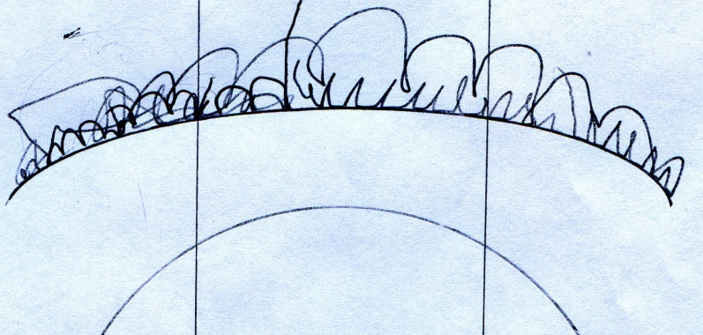
Praxim Haptic 3D Surface Emulation
Erica Wodzak
Davy Chiu
David Mountford
Ibrahim Gadala
Nicholas Adams

Slide 2
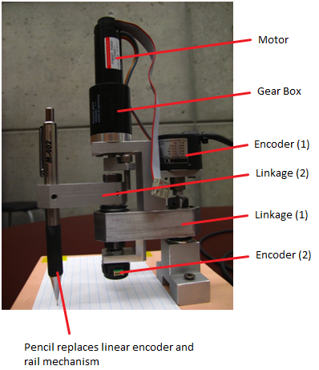
Outline
Background
Dynamic Constraint Concept
Functional Decomposition
Concepts Generation
Concept Selection

Slide 3
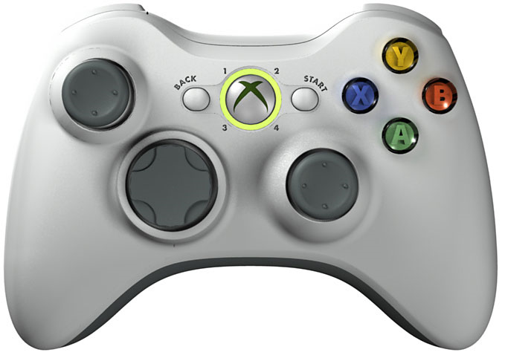
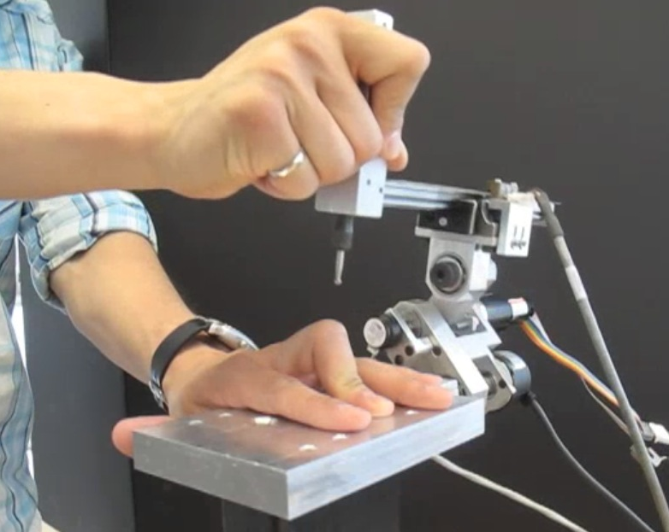
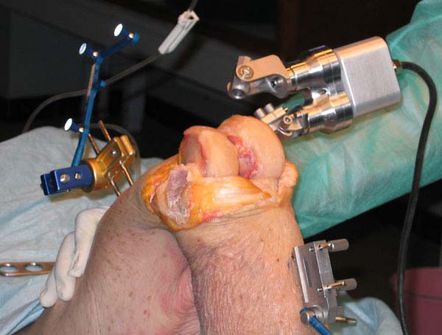
Project Background

Slide 4
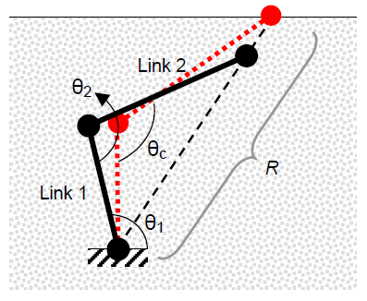
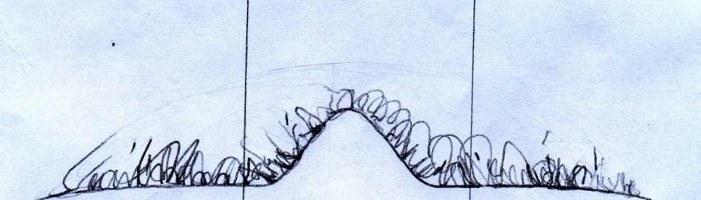
Dynamic Physical Constraint Concept

Slide 5
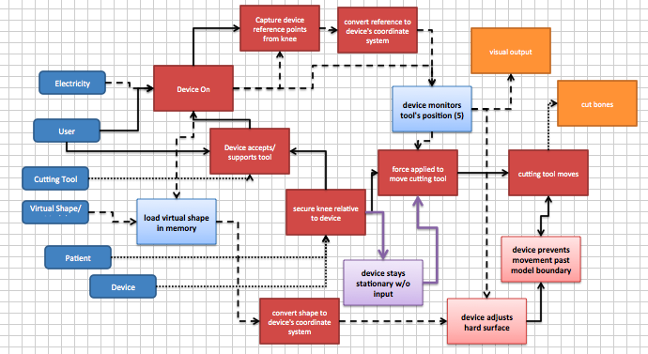
Functional Decomposition

Slide 6
Functional Decomposition
Device Stays In Position Under Gravitational Influence

Slide 7
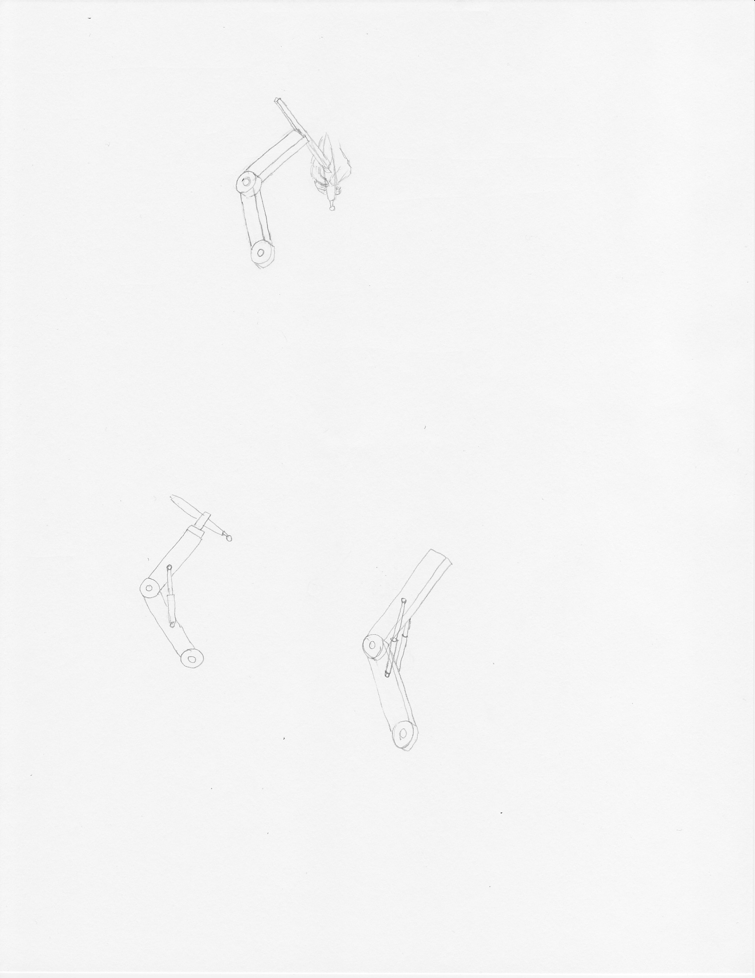
Concept Generation: High Joint Friction
Joint friction equal to arm’s free weight

Slide 8
Concept Generation: Hydraulics
Hydraulic damper resisting arm’s weight

Slide 9
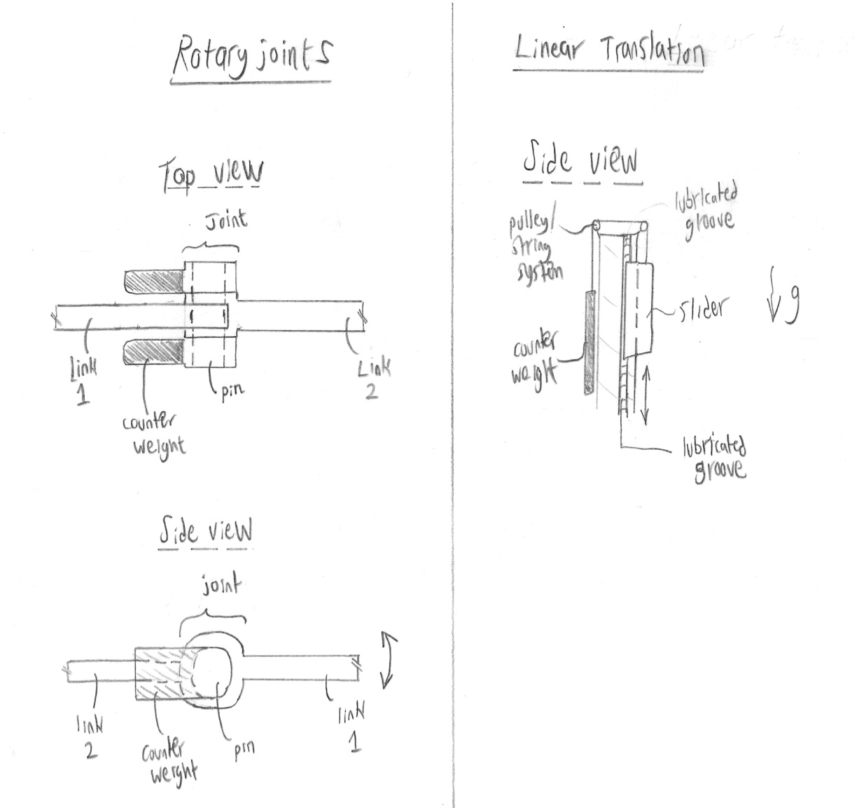
Concept Generation: Counterweight
Counterweight at joint balances the weight of the arm

Slide 10
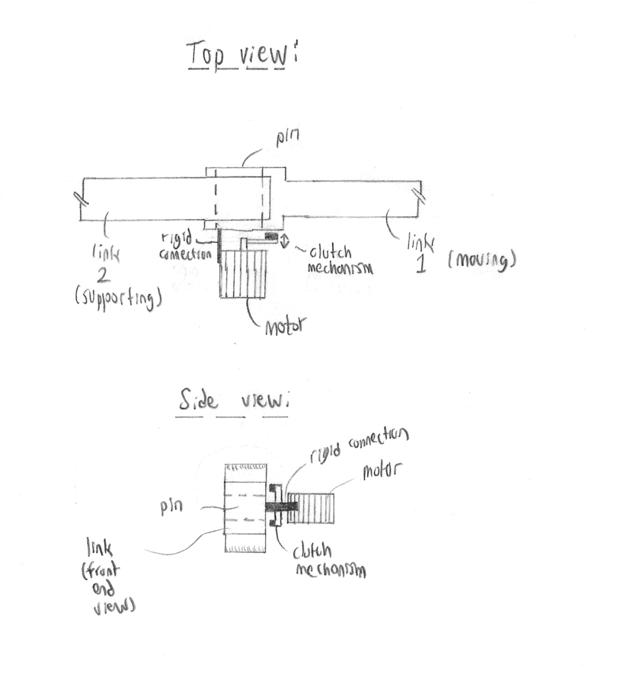
Concept Generation: Motor
Motor and clutch/brake mechanism prevents arm free-fall

